Slide 1

Traffic Correlation in Tor Source and Destination Prediction
Peter Byerley Rindal
Sultan Alanazi
Hafed Alghamdi

Slide 2
Overview
What is Tor Network?
Motivation
How does Tor work?
Tor Protocol Weaknesses and security Threats
Entry exit attack
Traffic pattern attacks
Implementation and Analysis
End-User awareness

Slide 3

What is Tor?
Tries to anonymize the source of network traffic
Normal internet encryption is not enough to protect your identity
Originally developed by the U.S. Navy for government communications
Now publicly maintained and has millions of users
Tor Browser enables anonymous web browsing
Free
Anyone can contribute to Tor Network!!!
Open source
Notes:
It was originally developed with the U.S. Navy in mind, for the primary purpose of protecting government communications. Today, it is used every day for a wide variety of purposes by normal people, the military, journalists, law enforcement officers, activists, and many others.

Slide 4
Motivation
Tor is Growing Rapidly
2+ million users
7000+ Relays
Internet security has become a ubiquitous problem
Tor could be a solution
OSU security club is planning to enable Tor Router
Some protocol level security concerns
Controversial usage of Tor network
Illegal activity
Government censorship

Slide 5
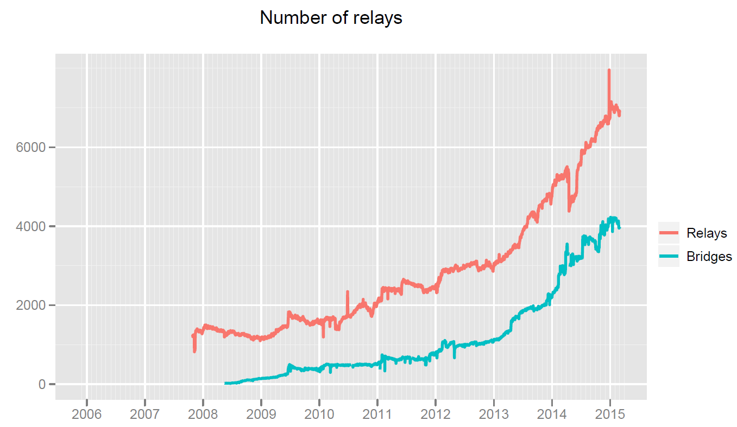
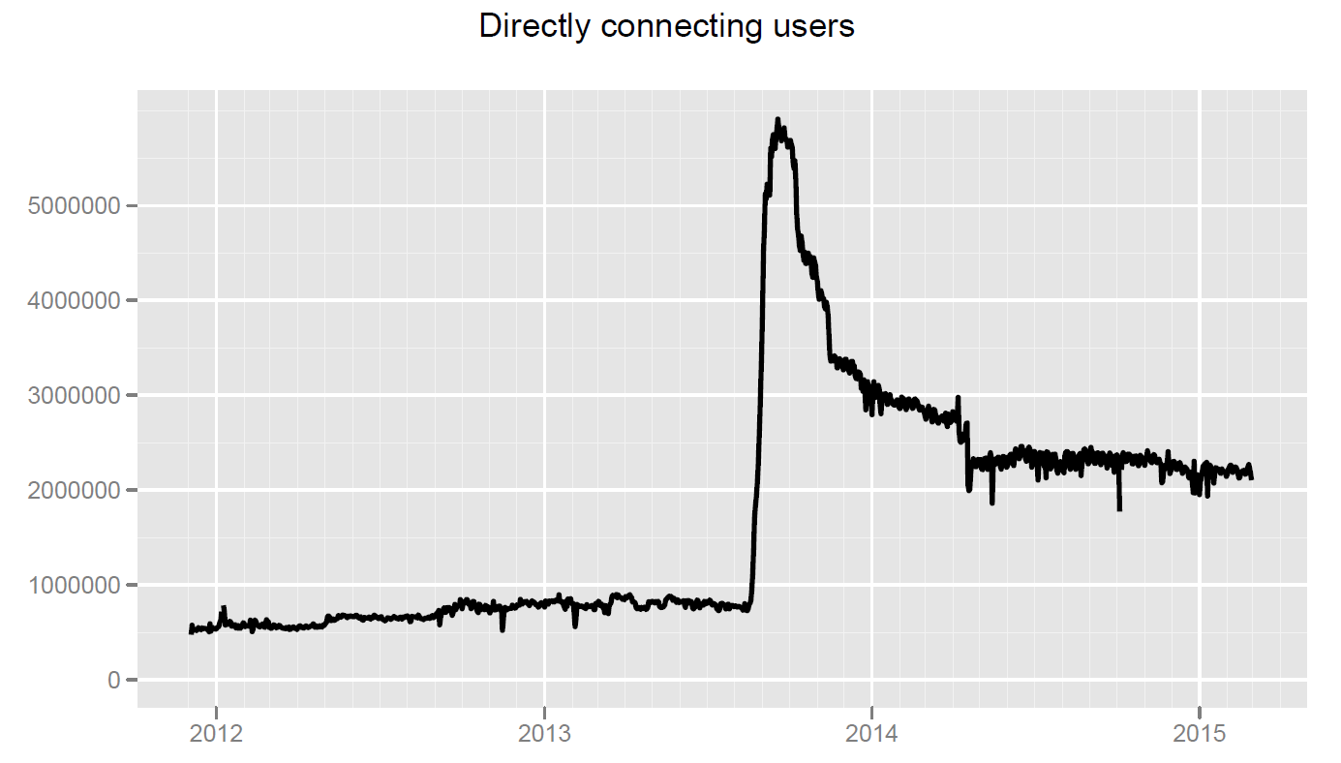
Tor Statistics
Country | Mean daily users
United States | 357736 (16.31 %)
Germany | 202671 (9.24 %)
Russia | 149724 (6.83 %)
France | 138143 (6.30 %)
United Kingdom | 96862 (4.42 %)
Spain | 86259 (3.93 %)
Brazil | 84009 (3.83 %)
Italy | 79735 (3.64 %)
Poland | 55358 (2.52 %)
Japan | 50956 (2.32 %)
[1]

Slide 6



How doesn’t Tor work?
Hi Lucy
Hi Charlie
Charlie
Lucy
Notes:
Visit a website using Tor browser software
Check Tor directory and obtain addresses for Tor relays.
Tor software selects random chain of relays donated by volunteers.
At the first relay, user's computer IP address is replaced by the relay's IP address.
The next relay only sees the address of the previous relay; no single relay knows the whole route.
This provides strong and anonymity protection.
If the user visits different sites, the same process will be repeated but with different random Chain of relays.
This preventing anyone from aggregating data on an anonymous person's activity.

Slide 7
How does Tor work?
Tor is effectively a large and sophisticated proxy service.
Instead of connecting to a sever directly, a “circuit” through several proxy (Relay) servers is created
All traffic is then routed through the circuit
Protocol level identification information is removed when passing through each relay
The destination can not determine the source of the traffic
Notes:
Visit a website using Tor browser software
Check Tor directory and obtain addresses for Tor relays.
Tor software selects random chain of relays donated by volunteers.
At the first relay, user's computer IP address is replaced by the relay's IP address.
The next relay only sees the address of the previous relay; no single relay knows the whole route.
This provides strong and anonymity protection.
If the user visits different sites, the same process will be repeated but with different random Chain of relays.
This preventing anyone from aggregating data on an anonymous person's activity.

Slide 8

How does Tor work?
Hi Lucy
Charlie
Hi anonymous
Lucy
Tor Relay (proxy)
Plaintext
Encrypted (TLS)
Notes:
Visit a website using Tor browser software
Check Tor directory and obtain addresses for Tor relays.
Tor software selects random chain of relays donated by volunteers.
At the first relay, user's computer IP address is replaced by the relay's IP address.
The next relay only sees the address of the previous relay; no single relay knows the whole route.
This provides strong and anonymity protection.
If the user visits different sites, the same process will be repeated but with different random Chain of relays.
This preventing anyone from aggregating data on an anonymous person's activity.

Slide 9
How does Tor work?
Charlie
Lucy
Notes:
Visit a website using Tor browser software
Check Tor directory and obtain addresses for Tor relays.
Tor software selects random chain of relays donated by volunteers.
At the first relay, user's computer IP address is replaced by the relay's IP address.
The next relay only sees the address of the previous relay; no single relay knows the whole route.
This provides strong and anonymity protection.
If the user visits different sites, the same process will be repeated but with different random Chain of relays.
This preventing anyone from aggregating data on an anonymous person's activity.

Slide 10
How does Tor work?
Charlie
Lucy
Notes:
Visit a website using Tor browser software
Check Tor directory and obtain addresses for Tor relays.
Tor software selects random chain of relays donated by volunteers.
At the first relay, user's computer IP address is replaced by the relay's IP address.
The next relay only sees the address of the previous relay; no single relay knows the whole route.
This provides strong and anonymity protection.
If the user visits different sites, the same process will be repeated but with different random Chain of relays.
This preventing anyone from aggregating data on an anonymous person's activity.

Slide 11
How does Tor work?
Charlie
Lucy
Notes:
Visit a website using Tor browser software
Check Tor directory and obtain addresses for Tor relays.
Tor software selects random chain of relays donated by volunteers.
At the first relay, user's computer IP address is replaced by the relay's IP address.
The next relay only sees the address of the previous relay; no single relay knows the whole route.
This provides strong and anonymity protection.
If the user visits different sites, the same process will be repeated but with different random Chain of relays.
This preventing anyone from aggregating data on an anonymous person's activity.

Slide 12
How does Tor work?
Charlie
Lucy
Notes:
Visit a website using Tor browser software
Check Tor directory and obtain addresses for Tor relays.
Tor software selects random chain of relays donated by volunteers.
At the first relay, user's computer IP address is replaced by the relay's IP address.
The next relay only sees the address of the previous relay; no single relay knows the whole route.
This provides strong and anonymity protection.
If the user visits different sites, the same process will be repeated but with different random Chain of relays.
This preventing anyone from aggregating data on an anonymous person's activity.

Slide 13
How does Tor work?
Charlie
Lucy
Notes:
Visit a website using Tor browser software
Check Tor directory and obtain addresses for Tor relays.
Tor software selects random chain of relays donated by volunteers.
At the first relay, user's computer IP address is replaced by the relay's IP address.
The next relay only sees the address of the previous relay; no single relay knows the whole route.
This provides strong and anonymity protection.
If the user visits different sites, the same process will be repeated but with different random Chain of relays.
This preventing anyone from aggregating data on an anonymous person's activity.

Slide 14




Circuit establishment
Client get a list of relays from a directory server
For each connection, the client select 3 or more relays at random*
An encrypted connection to the first relay is established.
Subsequent connection are established by piping them through the previous relays
The final relay performs a TCP handshake with the destination server
* The first one should not be at random (entry guard)
Notes:
Visit a website using Tor browser software
Check Tor directory and obtain addresses for Tor relays.
Tor software selects random chain of relays donated by volunteers.
At the first relay, user's computer IP address is replaced by the relay's IP address.
The next relay only sees the address of the previous relay; no single relay knows the whole route.
This provides strong and anonymity protection.
If the user visits different sites, the same process will be repeated but with different random Chain of relays.
This preventing anyone from aggregating data on an anonymous person's activity.

Slide 15

Circuit establishment
TLS
TLS
Charlie
OR1
OR2
Lucy
Create, c1, key
Created, c1, key’
Extend, c1, {OR2, key’’’}
Create, c2, key’’’
Created, c2, key’’’’
Extended, c1, {OR2, key’’’’}
Relay, c1, {{Hi Lucy}}
Relay, c2, {Hi Lucy}
Hi Lucy
Hi anonymous
Relay, c2, {Hi anonymous}
Relay, c1, {{Hi anonymous}}
{message} = encrypted message
Notes:
Visit a website using Tor browser software
Check Tor directory and obtain addresses for Tor relays.
Tor software selects random chain of relays donated by volunteers.
At the first relay, user's computer IP address is replaced by the relay's IP address.
The next relay only sees the address of the previous relay; no single relay knows the whole route.
This provides strong and anonymity protection.
If the user visits different sites, the same process will be repeated but with different random Chain of relays.
This preventing anyone from aggregating data on an anonymous person's activity.

Slide 16
Attacks
How well does this protocol hold up again traffic confirmation attacks
No one relay can know the whole path
What if all relays collude?
Anonymity is lost
Unlikely that all relays will collude (they are chosen randomly*)
What if only two relays collude? [2]
What if all relays are honest? [3]
Notes:
Visit a website using Tor browser software
Check Tor directory and obtain addresses for Tor relays.
Tor software selects random chain of relays donated by volunteers.
At the first relay, user's computer IP address is replaced by the relay's IP address.
The next relay only sees the address of the previous relay; no single relay knows the whole route.
This provides strong and anonymity protection.
If the user visits different sites, the same process will be repeated but with different random Chain of relays.
This preventing anyone from aggregating data on an anonymous person's activity.

Slide 17
Entry Exit attack

Slide 18
Threat model
Charlie
Lucy
Assume the entry and exit relays are colluding (reasonable?)
[2]
Notes:
Visit a website using Tor browser software
Check Tor directory and obtain addresses for Tor relays.
Tor software selects random chain of relays donated by volunteers.
At the first relay, user's computer IP address is replaced by the relay's IP address.
The next relay only sees the address of the previous relay; no single relay knows the whole route.
This provides strong and anonymity protection.
If the user visits different sites, the same process will be repeated but with different random Chain of relays.
This preventing anyone from aggregating data on an anonymous person's activity.

Slide 19
Attack
{{Hi Lucy}₁}₁
{{Hi Lucy}₁}₁
{{{Hi Lucy}₁}₁}₁
{{______}₂}₂
{hfhjfdsg}
{Hi Lucy}₁
Charlie
Lucy
dasdfsa
Hi Lucy
[2]
Notes:
Visit a website using Tor browser software
Check Tor directory and obtain addresses for Tor relays.
Tor software selects random chain of relays donated by volunteers.
At the first relay, user's computer IP address is replaced by the relay's IP address.
The next relay only sees the address of the previous relay; no single relay knows the whole route.
This provides strong and anonymity protection.
If the user visits different sites, the same process will be repeated but with different random Chain of relays.
This preventing anyone from aggregating data on an anonymous person's activity.

Slide 20
Attack
Charlie
Lucy
dasdfsa
[2]
Notes:
Visit a website using Tor browser software
Check Tor directory and obtain addresses for Tor relays.
Tor software selects random chain of relays donated by volunteers.
At the first relay, user's computer IP address is replaced by the relay's IP address.
The next relay only sees the address of the previous relay; no single relay knows the whole route.
This provides strong and anonymity protection.
If the user visits different sites, the same process will be repeated but with different random Chain of relays.
This preventing anyone from aggregating data on an anonymous person's activity.

Slide 21
Our Counter measure

Slide 22
Attack
{{Hi Lucy}₁}₁
{{______}₂}₂
{hfhjfdsg}
Charlie
Lucy
[2]
Notes:
Visit a website using Tor browser software
Check Tor directory and obtain addresses for Tor relays.
Tor software selects random chain of relays donated by volunteers.
At the first relay, user's computer IP address is replaced by the relay's IP address.
The next relay only sees the address of the previous relay; no single relay knows the whole route.
This provides strong and anonymity protection.
If the user visits different sites, the same process will be repeated but with different random Chain of relays.
This preventing anyone from aggregating data on an anonymous person's activity.

Slide 23
Our counter measures
Add additional authentication to each message
Each message needs to be validated at each relay
Will stop bad messages from reaching the exit relay
Will add additional overhead to the protocol
Current message look like: Relay, id, {{{message, MAC}}}
Proposed message look like: Relay, id, {{{message, MAC} MAC} MAC}
MAC = message authentication code
Notes:
Visit a website using Tor browser software
Check Tor directory and obtain addresses for Tor relays.
Tor software selects random chain of relays donated by volunteers.
At the first relay, user's computer IP address is replaced by the relay's IP address.
The next relay only sees the address of the previous relay; no single relay knows the whole route.
This provides strong and anonymity protection.
If the user visits different sites, the same process will be repeated but with different random Chain of relays.
This preventing anyone from aggregating data on an anonymous person's activity.

Slide 24







Our counter measure
{{Hi Lucy,$𝓜$}₁ ,$𝓜$}₁
{{Hi Lucy,$𝓜$}₁ ,$𝓜$}₁
{{______}₂,$𝓜$}₂
{{{Hi Lucy,$𝓜$}₁ ,$𝓜$}₁ ,$𝓜$}₁
{______}₂,$𝓜$
{Hi Lucy,$𝓜$}₁
{sdfgsdfsdsd}₁ ,sdfgsd
Charlie
Lucy
Hi Lucy
Mac({sdfgsdfsdsd} ) $≠$sdfgsd
Notes:
Visit a website using Tor browser software
Check Tor directory and obtain addresses for Tor relays.
Tor software selects random chain of relays donated by volunteers.
At the first relay, user's computer IP address is replaced by the relay's IP address.
The next relay only sees the address of the previous relay; no single relay knows the whole route.
This provides strong and anonymity protection.
If the user visits different sites, the same process will be repeated but with different random Chain of relays.
This preventing anyone from aggregating data on an anonymous person's activity.

Slide 25
Current Counter measure

Slide 26


Prob. of selecting compromised relays
Tor Network
Tor has about 7000 public relays
Each volunteer to be a relay
Malicious relays could easily volunteer…
Imagine a malicious party controls 10 relays
$$P\left[Entry=bad, Exit=bad\right]≈\frac{10}{7,000}∗\frac{9}{6,999} \\ ≈\frac{9}{4,899,300}$$
New circuit is created every 10 minutes
After 1 month of continuous use $P\left[Entry=bad, Exit=bad\right]≈\frac{1}{126}$

Slide 27
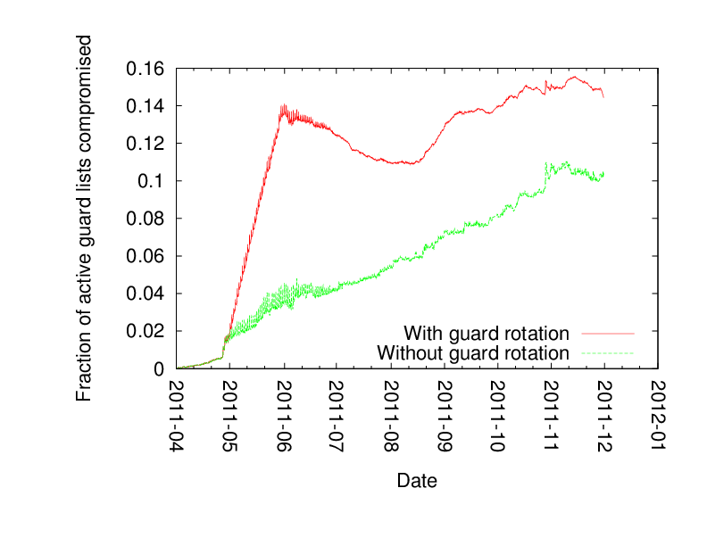

Current counter measure
Tor Network
Entry guards
Always use the same entry relay into the network
Imagine a malicious party controls 10 relays
$$P\left[Entry=bad, Exit=bad\right]≈\frac{10}{7000}∗\frac{9}{6999} \\ ≈\frac{9}{4899300}$$
New circuit is created every 10 minutes
After 1 month of continuous use $P\left[Entry=bad, Exit=bad\right]≈\frac{1}{700}∗min\left(1 ,\frac{9}{6999}∗1 month\right)$ $≈\frac{1}{700}$
[4]

Slide 28
Traffic pattern attack

Slide 29
Traffic pattern attacks
Tor relays try and limit latency by forwarding traffic as fast as possible
As such, messages keep their relative timing
Can be used as an attack [4]
Potentially the worst attack…
Very hard to detect
Tor Network
Charlie
Lucy

Slide 30
Qualifying the attacks
Don’t think tor is completely broken…
Most of the attacks rely on traffic confirmation where the attack suspects the destination
This is often more than enough for targeted attack
Limits the effectiveness of “dragnet” surveillance
Some work has shown course traffic pattern surveillance can still be moderately effective at dragnet surveillance on a large set of users
Base rate fallacy [5]

Slide 31

Implementation
Implementation
Primitive Tor network Application in ns3
Implementing malicious entry, exit relay attack and proposed counter measure.

Slide 32
Conclusion
Fewer entry points you use the better
Targeted attacks are still effective
Use with caution if you suspect an active nation state like adversary

Slide 33
Q&A

Slide 34
Sources
[1] The Tor Project https://metrics.torproject.org/
[2] Xinwen Fu, et al. One Cell is Enough to Break Tor’s Anonymity, https://www.blackhat.com/presentations/bh-dc-09/Fu/BlackHat-DC-09-Fu-Break-Tors-Anonymity.pdf
[3] Alex Biryukov, et al. Trawling for Tor Hidden Services: Detection, Measurement, Deanonymization, http://www.ieee-security.org/TC/SP2013/papers/4977a080.pdf
[4] Tariq Elahi, et al. Changing of the Guards: A Framework for Understanding and Improving Entry Guard Selection in Tor, http://freehaven.net/~arma/cogs-wpes.pdf
[5] How I Learned to Stop Ph34ring NSA and Love the Base Rate Fallacy http://archives.seul.org/or/dev/Sep-2008/msg00016.html
[6] Mike Perry. Experimental Defense for Website Traffic Fingerprinting, https://blog.torproject.org/blog/experimental-defense-website-traffic-fingerprinting

